Slide 1
Review Session
Vijayalakshmi Anand

Slide 2
Data Preprocessing

Slide 3
Data Pre processing
Major task in Data preprocessing
Data Cleaning
Data Integration
Data transformation
Data reduction

Slide 4
Data Cleaning
Fill in missing values
Global constant: e.g., “unknown”, NA
Mean value
The most probable value: using Bayesian formula or decision tree or regression
Noise
Binning (also used for discretization)
Regression
Clustering
Inconsistencies
Manually or semiautomatic tool

Slide 5


Data Integration
Data Redundancy
1. Chi square test 2. Correlation coefficient 3. Covariance
Points to remember:
1. Chi square test –Nominal attribute – Gender, Zip code, Customer Id, HairColour etc
Correlation coefficient & Covariance –Numerical value
use the covariance matrix when the variable are on similar scales and the correlation matrix when the scales of the variables differ.
Correlation coefficient - used to determine when a change in one variable can result in a change in another.
Covariance -used to determine how much two random variables vary together
2. Correlation coefficients lie between -1 and +1, Covariance can take any value between -∞ and +∞.
Correlation coefficient
-1=negative correlation .one increase another decrease
+1-Postive correlation one increase other also increase
0-No relationship
Covariance
+ -Both vary in same direction
- -both vary in opposite direction
0 -no relation

Slide 6
Chi square test-Steps
1. Formulate Hypothesis
Null hypothesis(H0)
Alternate Hypothesis(H1)
2. Create Contingency matrix
3. Find expected value: row total*column total/total
4. Apply chi square formula : ∑(O-E)²/E (Calculated value)
5.Find degrees of Freedom: (no of rows-1)(no of columns-1)
6.Significant level(α)will be given( if not) ,select 0.05
7.Find the value of intersection of (α) and degree of freedom(df) in the table (theoretical value )
8.Compare calculated value and theoretical value
If χ2 value >theoretical value then we can reject the null hypothesis
If χ2 value <=theoretical value –accept the null hypothesis

Slide 7
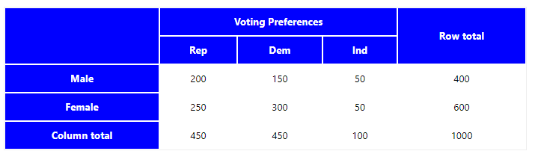
Chi square test
A public opinion poll surveyed a simple random sample of 1000 voters. Respondents were classified by gender (male or female) and by voting preference (Republican, Democrat, or Independent). Results are shown in the contingency table below.
Is there a gender gap? Do the men's voting preferences differ significantly from the women's preferences? Use a 0.05 level of significance.

Slide 8
1.Hypothesis
H_{o}: Gender and voting preferences are independent.
H_{a}: Gender and voting preferences are not independent.
2. E_{r,c(expected value)} = (n_{r} * n_{c}) / n
E_{1,1} = (400 * 450) / 1000 = 180000/1000 = 180 E_{1,2} = (400 * 450) / 1000 = 180000/1000 = 180 E_{1,3} = (400 * 100) / 1000 = 40000/1000 = 40 E_{2,1} = (600 * 450) / 1000 = 270000/1000 = 270 E_{2,2} = (600 * 450) / 1000 = 270000/1000 = 270 E_{2,3} = (600 * 100) / 1000 = 60000/1000 = 60
3.Χ² = Σ [ (O_{r,c} - E_{r,c})² / E_{r,c} ]
Χ² = (200 - 180)²/180 + (150 - 180)²/180 + (50 - 40)²/40 + (250 - 270)²/270 + (300 - 270)²/270 + (50 - 60)²/60 Χ² = 400/180 + 900/180 + 100/40 + 400/270 + 900/270 + 100/60 Χ² = 2.22 + 5.00 + 2.50 + 1.48 + 3.33 + 1.67 = 16.2

Slide 9
4. DF = (r - 1) * (c - 1) = (2 - 1) * (3 - 1) = 2
5. α=0.05 DF=2
Theoretical value=5.991
6. Chi square value(16.2)>5.991 (theoritical value.
Reject Null hyposthesis - Gender and voting preferences are not independent(dependent)

Slide 10
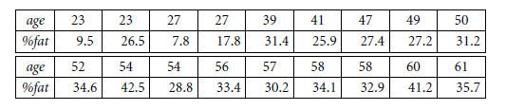
Correlation coefficient
Given below is the data for age and body fat:
Calculate the correlation coefficient . Are these two attributes positively or negatively correlated?

Slide 11
Mean Age = 1 18 × 836 = 46.4
Mean %Fat = 1 18 × 518.1 = 28.8
σ_{age} =12.8 σ_{fat =}9
rAge,%Fat = 0.82. We can conclude that both quantities are positively correlated, since rAge,%Fat > 0

Slide 12

Covariance
Daily returns for two stocks using the closing prices are given below and find out the stocks move in same direction or opposite direction
Day | Mobiles | Laptops
1 | 6 | 20
2 | 5 | 10
3 | 4 | 14
4 | 3 | 5
5 | 2 | 5
E(Mobiles) =6+5+4+3+2/5 =20/5 =4
E(laptops)=20+10+14+5+5/5=54/5=10.80
Cov(mobiles,Laptops) =
Therefore, given the positive covariance we can say that stock prices for both companies rise together.

Slide 13

A doctor collected following sample temperature data for the patients on six days of a week. Find the covariance coefficient for the given two attributes
Temp. 98 87 90 85 95 75
No. of
Patients 15 12 10 10 16 7
Answer :
E(A) = ( 98 + 87 + 90 + 85 + 95 + 75) / 6 = 530 / 6 = 88.33
E(B) = ( 15 + 12 + 10 + 10 + 16 + 7 ) / 6 = 70 / 6 = 11.67
E( A.B) = ( 98 *15 + 87*12 + 90 *10 + 85 *10 + 95 *16 + 75 *7) / 6 = 6309 / 6 = 1051.5
Cov (A, B) = 1051.5 – 88.33 * 11.67 = 20.68

Slide 14
Data transformation
Smoothing-remove noise from the data
Binning , regression and clustering
Attribute construction / selection (or feature construction)
Aggregation
Concept hierarchy generation for nominal data
Normalization
Discretization

Slide 15
Binning-Steps
Two methods
Equal Frequency Binning : bins have equal frequency.
Equal Width Binning : bins have equal width with a range of each bin are defined as [min + w], [min + 2w] …. [min + nw] where w = (max – min) / (no of bins).
General Steps
Sort the array of given data set.
Divides the range into N intervals, Use anyone method(equal frequency or equal width)
Store mean/ median/ boundaries in each row.

Slide 16
Binning
Smoothening the below data by using median binning technique
2050,410, 451, 533,492, 533, 574, 615, 656, 697, 779,738, 820, 943, 984, 1025, 1066, 1107, 1148, 1189, 1271, 1353, 1312, 1394, 1435, 1763,1517
1). Sorting the data
410, 451, 492, 533, 533, 574, 615, 656, 697, 738, 779, 820, 943, 984, 1025, 1066, 1107, 1148, 1189, 1271, 1312, 1353, 1394, 1435, 1517, 1763, 2050
2). Partition into (equal-frequency) bins
Bin 1 : 410, 451, 492
Bin 2 : 533, 533, 574
Bin 3 : 615, 656, 697
Bin 4 : 738, 779, 820
Bin 5 : 943, 984, 1025
Bin 6 : 1066, 1107, 1148
Bin 7 : 1189, 1271, 1312
Bin 8 : 1353, 1394, 1435
Bin 9 : 1517, 1763, 2050

Slide 17
3). Smoothing by bin medians
Bin 1 : 451, 451, 451
Bin 2 : 533, 533, 533
Bin 3 : 656, 656, 656
Bin 4 : 779, 779, 779
Bin 5 : 984, 984, 984
Bin 6 : 1107, 1107, 1107
Bin 7 : 1271, 1271, 1271
Bin 8 : 1394, 1394, 1394
Bin 9 : 1763, 1763, 1763

Slide 18

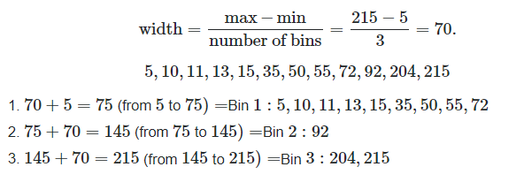
Equal width -Binning
Data set

Slide 19
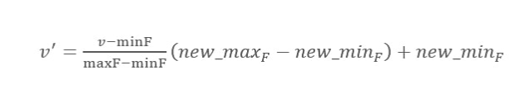


Normalization
1.Min-Max normalization
2.Decimal scaling
3.Zscore

Slide 20

Normalization
Consider the following data (in increasing order) for the attribute age:
13, 15, 16, 16, 19, 20, 20, 21, 22, 22, 25, 25, 25, 25, 30, 33, 33, 35, 35, 35, 35, 36, 40, 45, 46,52, 70.
Use min-max normalization to transform the value 35 for age onto the range [0.0, 1.0].
35-13/70-13(1-0)+0
=22/57=0.38

Slide 21
Data Reduction
Data reduction strategies
Dimensionality reduction, e.g., remove unimportant attributes
Wavelet transforms
Principal Components Analysis (PCA)
Feature or attribute subset selection
Numerosity reduction (some simply call it: Data Reduction)
Regression and Log-Linear Models
Histograms, clustering, sampling
Data cube aggregation
Data compression

Slide 22
Data Exploration

Slide 23
Data types
Record
Graph and network
Ordered
Spatial, image and multimedia

Slide 24
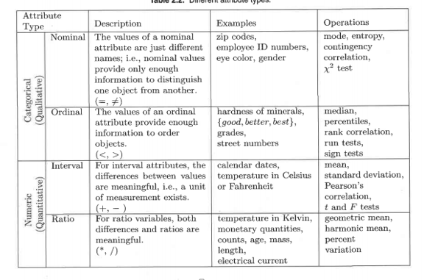
Attribute types

Slide 25
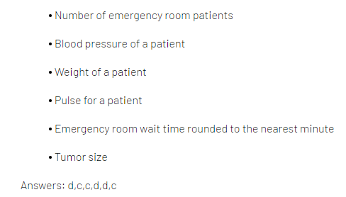
1..
Favorite candy bar
Weight of luggage
Year of your birth
Egg size (small, medium, large, extra large, jumbo)
2.
Military rank
Number of children in a family
Jersey numbers for a football team
Shoe size
Answers: N,R,I,O and O,R,N,I
Let us take an example of “100 meter race” in a tournament where three runners are participating from three different states of Malaysia. Each runner is assigned a number(displayed in uniform) to differentiate from each other. Once the race is over, the winner is declared along with the declaration of first runner up and second runner up based on the criteria that who reaches the destination first, second and last. During the tournament, judge is asked to rate each runner on the scale of 1–10 based on certain criteria. The time spent by each runner in completing the race. Find all the attribute type
1 The number displayed in the uniform to identify runners is an example of nominal scale.
2. The rank order of runners such as “second runner up as 3”, “first runner up as 2” and the “winner as 1” is an example of ordinal scale.

Slide 26


Basic Statistical Descriptions of Data
Central latency –Mean, Median, Mode
Mean-average
Median-Middle value
Mode-Most frequent value
Five number summary –Box plot
The minimum – this is the smallest value in our data set.
The first quartile – this number is denoted Q₁ and 25% of our data falls below the first quartile.
The median – this is the midway point of the data. 50% of all data falls below the median.
The third quartile – this number is denoted Q₃ and 75% of our data falls below the third quartile.
The maximum – this is the largest value in our data set.
Variance :
Standard deviation:

Slide 27
Box plot or five number summary
Find out the outlier of the given data Using Box plot
6 47 49 15 42 41 7 39 43 40 36
Ans: Sorted data
6,7,15,36,39,40,41,42,43,47,49
Q1=15
Q2 =40
Q3=43
IQR: Q3-Q1=28
Extremely high value =43+1.5*28=85
Extremely low value =15-1.5*28=27
Value less than 27 greater than 85 outlier
The outlier are 6,7,15

Slide 28
Calculate variance and standard deviation for the following data?
x 2 4 6 8 10
f 3 5 9 5 3
Answer:
Mean= ∑fx/∑f= 150/25= 6
Hence, variance= ∑fD²/N= 136/25= 5.44
And standard deviation= √(5.44)= 2.33 standard deviation for the following data

Slide 29
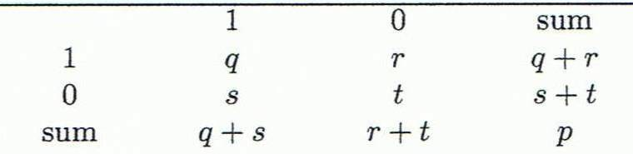
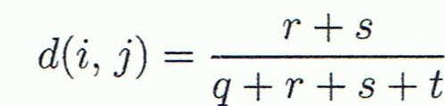
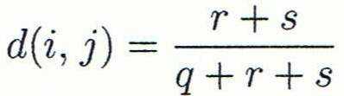
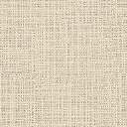
Proximity measure
Nominal attributes
Binary attributes
1.Compute dissimilarity matrix from the below table
2.Symmetric binary dissimilarity
3.Asymmetric binary dissimilarity
Object j
Object i
m - the number of matches
p - the total number of attributes describing the objects

Slide 30
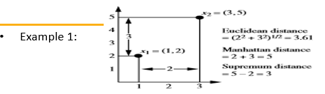
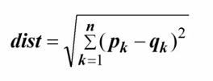

Proximity measure-Numeric attribute
Numeric attribute
Euclidean distance
Manhattan distance
Supremum

Slide 31
Determine the distance between two objects represented by attribute values (1,6,2,5,3) ,(3,5,2,6,6) by using Manhattan, Euclidean , L ∞ norm distance metrics.
Answer
(x 1 ,x 2 ,x 3 ,x 4 ,x 5 ) = (1, 6, 2,5, 3)
(y 1 ,y 2 ,y 3 ,y 4 ,y 5 ) = (3, 5, 2, 6, 6)
Euclidean Distance is
= 3.872983
Manhattan Distance is
D(x,y) = |x 1 -y 1 |+|x 2 -y 2 |+|x 3 -y 3 |+|x 4 -y 4 |+|x 5 -y 5 |
=7
L ∞ norm Distance is
D(x,y) = Max ( |x 1 -y 1 |,|x 2 -y 2 |,|x 3 -y 3 |,|x 4 -y 4 |,|x 5 -y 5 | )
= 3

Slide 32
Proximity measure-Ordinal, mixed
Ordinal data
1.Find Mf(is to replace each value by its rank)
2.Normalize the value based on ranking
3.Compute dissimilarity matrix
Mixed data
1.Calculate dissimilarity matrix for each attribute separately
2.Compute dissimilarity matrix for all type of attributes
=1

Slide 33
Cosine similarity
Consider three documents D1, D2 and D3, represented by the following document- term matrix. Identify the most similar document pair using cosine similarity measure
Answer:
cos( d 1 , d 2 ) = (d 1 · d 2 ) / ||d 1 || ||d 2 ||
cos(d1,d2) = 0.5012
cos(d1,d3) = 0.9 Hence, D1 and D3 is the most similar document pair
cos(d2,d3) = 0.36
Terms Document ID | D1 | D2 | D3
Data | 3 | 1 | 4
Mining | 2 | 0 | 5
Knowledge | 0 | 0 | 2
Databases | 1 | 4 | 1
Performance | 1 | 1 | 3

Slide 34
Cosine similarity
Define Cosine similarity and discuss the Cosine similarity of the following cases and comment
a) “ BITS Offered Data Mining course at WASE program”
“ WILP offered Data Mining as a compulsory course in M Tech”
b) “ Database Management course is a prerequisite for Data Mining”
“ Database Management is not offered in WILP”

Slide 35
Classification

Slide 36
Differences
Classification/prediction
Training data/test data
Supervised learning/unsupervised learning
Lazy learning/eager learning
Overfitting /under fitting
Post pruning /pre pruning

Slide 37
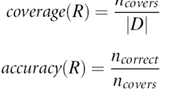

Classification
Decision tree algorithm
graphical representation
node ,leaf node and relationship
Best node-Information gain, gini index, misclassification error
Rule based algorithm-Rule based
If (condition) then (class)
Best Rule

Slide 38
Entropy ,Gini index ,misclassification error
Gini index
Misclassification error
Entropy

Slide 39
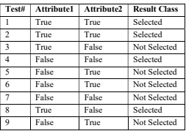
Entropy –information gain
Consider the results available for a metallic element test for a binary classification.
i. Calculate the entropy of these set of tests.
ii. Calculate information gain for Attribute1 and Attribute2
iii. What is better split as per Information gain.

Slide 40
Information gain
1.4 ‘Selected’ results and 5 ‘Not Selected’ results.
Entropy = −4/9 log2(4/9) − 5/9 log2(5/9) = 0.9911.
2. Matrix for attribute1:
Selected Not Selected
True 3 1
False 1 4
The entropy for attribute1 is
4/9 [− (3/4) log2(3/4) − (1/4) log2(1/4)] + 5/9[− (1/5) log2(1/5) − (4/5) log2(4/5)]
= 0.7616.
Information gain for attribute1 is: 0.9911 − 0.7616 = 0.2294.
Similarly,
The entropy for attribute2 is
5/9[− (2/5) log2(2/5) − (3/5) log2(3/5)] + 4/9[− (2/4) log2(2/4) − (2/4) log2(2/4)]
= 0.9839. 1.5 marks
Information gain for attribute2 is: 0.9911 − 0.9839 = 0.0072. 1 mark
3.Attribute1

Slide 41
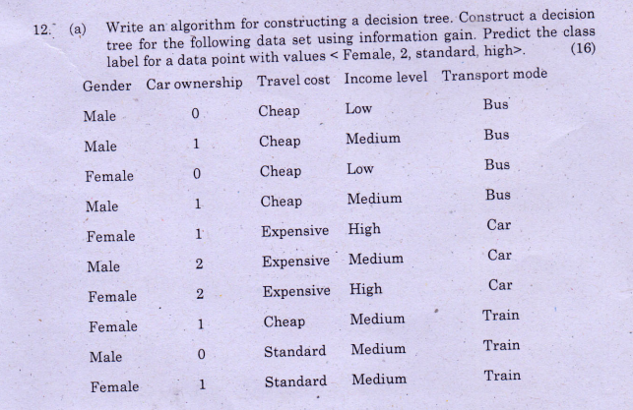
Decision tree –information gain-Exercise

Slide 42
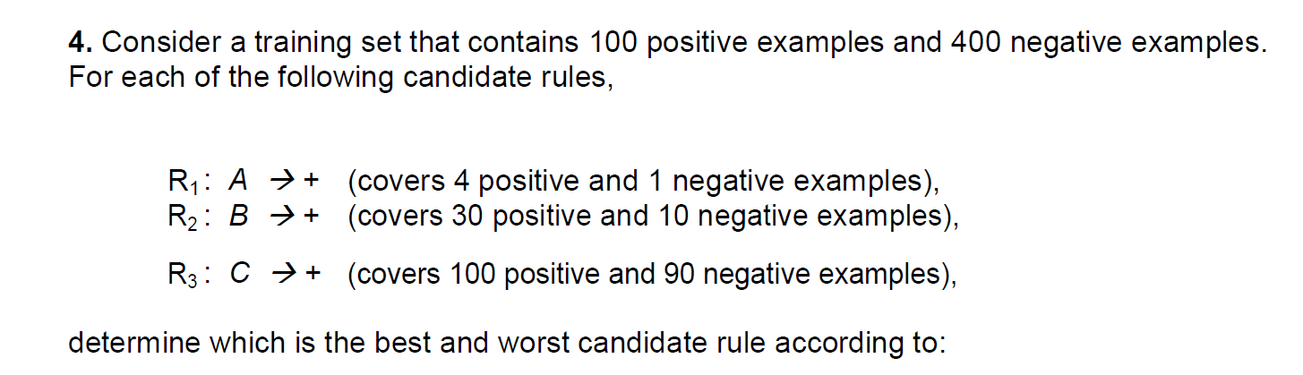
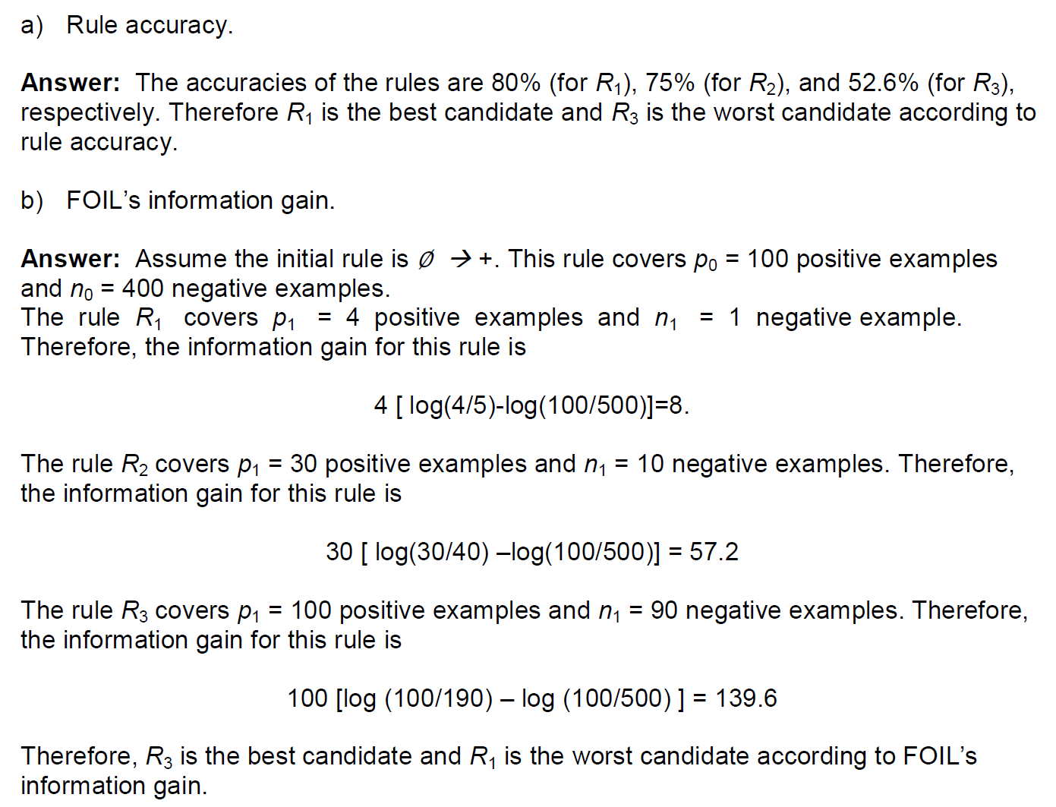
Rule base classification -Example

Slide 43
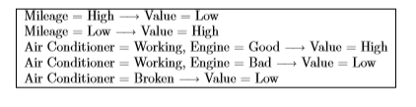
Consider a binary classiﬁcation problem with the following set of attributes and attribute values:
• Air Conditioner = {Working, Broken}
• Engine = {Good, Bad}
• Mileage = {High, Medium, Low}
• Rust = {Yes, No} Suppose a rule-based classiﬁer produces the following rule set:
Are the rules mutually exclustive? Answer: No
Is the rule set exhaustive? Answer: Yes
Is ordering needed for this set of rules? Answer: Yes because a test instance may trigger more than one rule.
Do you need a default class for the rule set? Answer: No because every instance is guaranteed to trigger at least one rule.

Slide 44
Gini index
Consider 10 samples which split into 3 classes. The first class gets 4 samples, the second gets 5 and the third class
gets 1 sample. Compute GINI impurity for the distribution.
Answer:
The GINI impurity
P(C1) = 4/10 = 0.4
P(C2) = 5/10 = 0.5
P(C3) = 1/10 = 0.1
Gini impurity i(n) = 1- 0.4 2 – 0.5 2 - 0.1 2 = 0 .58

Slide 45
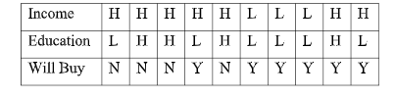
Consider the following data set (with two attributes and two possible classes Y, N)
for a binary class problem. The attributes are nominal with two possible values.
We intend to create decision tree model.
Calculate the gain in the Gini index when splitting on Income and Education.Which attribute would the decision tree induction algorithm choose?
Answer:
The overall gini before splitting is:
G orig = 1 − 0.4 2 − 0.6 2 = 0.48
The gain in gini after splitting on Income is:
G Income=H = 1 – (4/7) 2 – (3/7) 2 = 0.4898; G Income=L = 1 – (3/3) 2 – (0/3) 2= 0.0
Δ = G orig – (7/10)* G Income=H – (3/10)* G Income=L = 0.1371
The gain in gini after splitting on B is:
G Education=H = 1 – (1/4) 2 – (3/4) 2 = 0.3750; G Education=L = 1 – (1/6) 2 –
(5/6) 2 = 0.2778
Δ = G orig – (4/10)* G Education=H – (6/10)* G Education=L = 0.1633
Therefore, attribute Education will be chosen to split the node

Slide 46
Regression
Y=a+bx+error(Syx)

Slide 47

Regression
The XYZ college proposed an application where the system should predict the score of a
student in final exam based on their midterm score. To build this system, committee members
suggested to use regression analysis. As an input they have collected the past data for midterm
and final examscore obtained for students in a database course as given below;
a) Plot the data. Do x and y seem to have a linear relationship?
b) Use linear regression method for the prediction of a student’s final exam grade based
on the student’s midterm grade in the course.
c) Predict the final exam grade of a student who received an 86 on the midterm exam.

Slide 48
Answer:
a) Yes, from the scatter graph, it would appear that x and y have a linear relationship.
b) The equation for predicting a student’s final exam grade based on the student’s
midterm grade is y = 32.028 + 0.5816x.
c) y = 32.028 + (0.5816)(86) = 82.045. Therefore, we would predict that a student who received an 86 on the midterm would get 82 on the final exam.

Slide 49
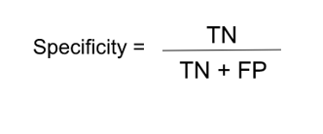

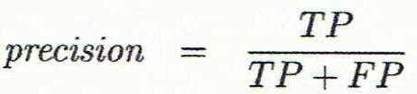



Evaluation measure-Classification model

Slide 50
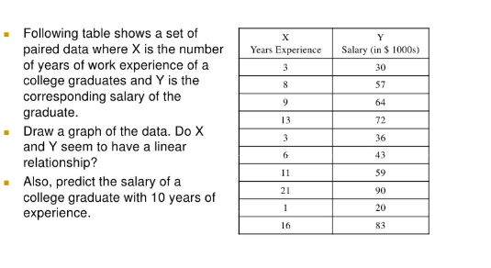
Linear regression-Exercise

Slide 51
Evaluation measure
How do you evaluate a classifier when there is a class imbalance?
Answer: In normal case, accuracy and error rate can help. In case of class imbalance, we need specificity and sensitivity

Slide 52
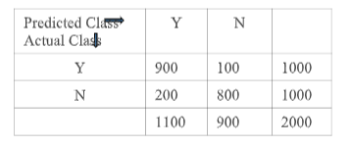
Following table shows results of classification for a 2-class problem. Consider ‘Y’and ‘N’ as two classes. Calculate Precision, Recall, and F-score of the classifier forclass ‘Y’.
Answer: Precision = 900/1100 = 0.82 Recall = 900/1000 = 0.9
F-score =(2*0.82*0.9)/(0.82+0.9) ~ 0.858

